Slide 1
WildPackaging
Profession in poly bags
Brochure
泰州市比特福料新材料有限公司
延时符

Slide 2
01 Compnay Profile
目
02 Products
Contents
03 Our Team
录
04 Quality System
05 Contact Us

Slide 3
Company Profile
TAIZHOU WILDPACKAGING CO.,LTD. IS EXPERTISING ON PLASTIC BAGS MANUFACTURING. PRODUCTS MAINLY INCLUDE PLASTIC BAGS ESPECIALLY CPE SLIDER BAG,LDPE ZIPPER BAGS, SLIDER FOOD BAGS,DELI ZIPPER BAG, T-SHIRT FREEZER BAG WHICH ARE ALL MET WITH FDA STANDARDS,
TAIZHOU WILD PACKAGING CO.,LTD.OWNS AN AREA ABOUT 22000 SQUARE METERS, AND HAS BECAME A GLOBAL PROFESSIONAL PLASTIC BAG MANUFACTURING FACTORY. WE PRACTICE WITH INTERNATIONAL QUALITY STANDARDS OF ISO-90001, QS, BSCI, BRC AND GMP AND GOOD RECORD OF WCA, THE FINE QUALITY PRODUCTS MEET WITH REQUIREMENTS OF GBLOBAL SUPERMARKETS AND CATERING, AND MAKE US THE MOST WELCOMED SUPPLIER IN YANGTS RIVER AND SHANGHAI DELTA AREA. WE ARE EMPLOYING 120 FULL-TIME WORKING MEMBERS, 99% OF OUR PPRODUCTS ARE EXPORTED TO USA,GERMANY, RUSSIA, UK, TURKEY, ETC. OUR ANNUAL PRODUCTION CAPACITY IS UP TO 6000 METRIC TONS. THERE ARE BLOWING , PRINTING,BAGS CUTTING AND PACKING WORKSHOP,WE HAVE MORE THAN 80 UNIT MACHINES IN OUR FACTORY NOW.
WELCOME TO WORK WITH US AND BUILD MUTUAL TOGETHER!
Quality first !
Deliver on time！
Sever 24 hours！
延时符

Slide 4
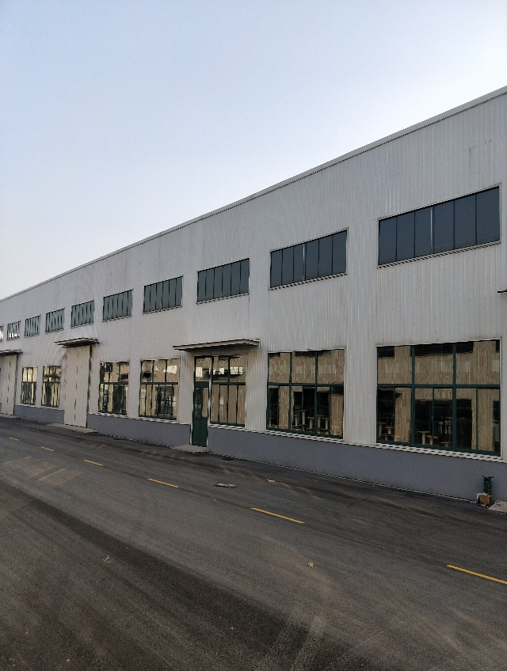
Our Team
professional
young
dreamful
We are a team with strong faith, we have been focus on our products for many years.
We are young, we make our way with passion !
We are a team with focus, we believe customer’s satisfaction come from top quality and best service, we did it !
We are a team with dream, we come together from all around China to fulfill our dream, to be top enterprise , not biggest one , but best one!
延时符

Slide 5
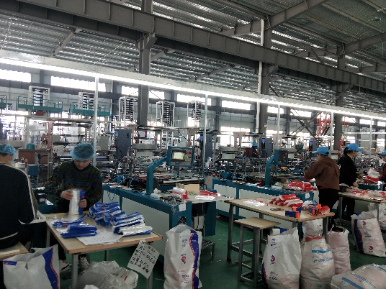
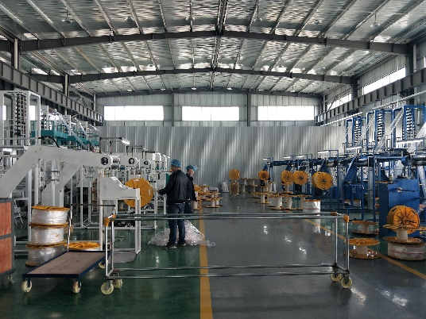
instuction
TAIZHOU WILDPACKAGING CO.,LTD.
LDPE Zip Lock Bags
LDPE Slider Zipper Bags
CPE Slider zipper bags
LDPE Tie Handle Bags In Roll
延时符

Slide 6
Taizhou WildPackaging Co.,Ltd.
泰州市比特福新材料有限公怀
Our Main Products
LDPE Slider Zipper Bags, CPE Slider Zipper Bags
LDPE Reclosable Bags, Zipper Bags, Zip lock bags
LDPE Saddle Zipper Bags, Saddle Slider Bags
LDOE Roll T-shirt freezer Bags
延时符

Slide 7
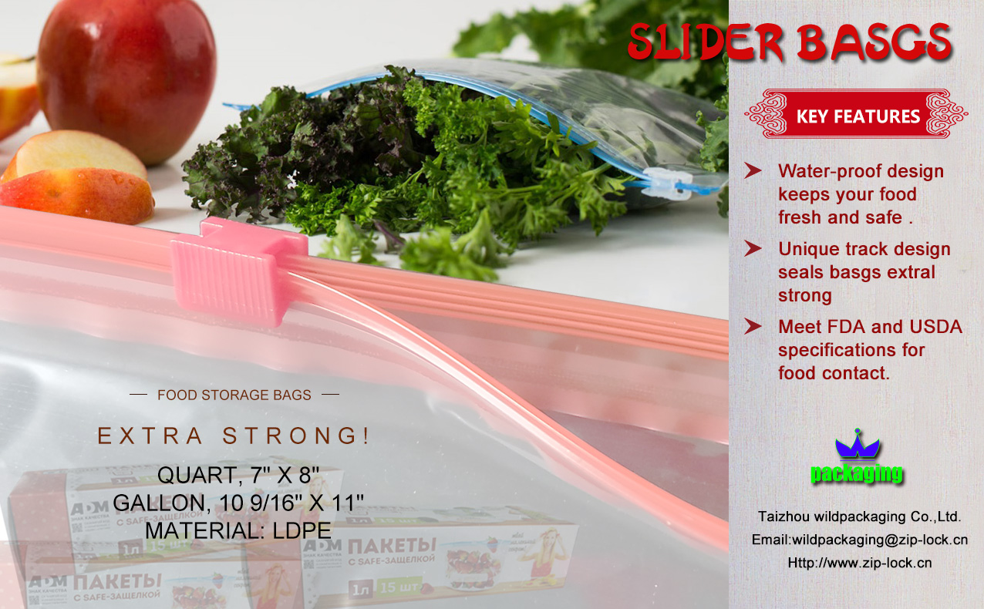
Slider Bags
延时符

Slide 8
Double zipper bags
延时符

Slide 9
Colored lip zipper bags
延时符

Slide 10
Double Track Bags
延时符

Slide 11
Freezer Bags
延时符

Slide 12
Medicine Envelop
延时符

Slide 13
Specimen Bag
延时符

Slide 14
Die cut Zipper Bags
延时符

Slide 15
Saddle Zipper Bags

Slide 16
Bio Degradable Zip Bags

Slide 17
Bio Degradable Zip Bags

Slide 18
Taizhou WildPackaging Co.,Ltd.
泰州市比特福新材料有限公司
Contact Us
https://www.wildpackaging.cn
Email: wildpackaging@zip-lock.cn
Add: NO.29,Runjiang Rd,High-Tech District,Taizhou City,Jiangsu Province,China
Post Code:225300
Contact: Peter Zong
Contact Us by Wechat
Cell:0086 13914404658
延时符

Slide 19
Taizhou WildPackaging Co.,Ltd.
泰州市比特福新材料有限公司
Thanks for watching!
https://www.zip-lock.cn
wildpackaging@zip-lock.cn
延时符

